Slide 1
Evaluating HPC Scheduling Strategies for Urgent Workloads
Nov 21, 2025, WIUHPC Workshop at SC25
Ketan Maheshwari, Anderson Borch (Colorado State Univ), Jordan Webb, Brian Etz, Ross Miller, Frederic Suter, Sarp Oral, Rafael Ferreira da Silva
Oak Ridge National Laboratory

Slide 2
Overview
A study and analysis of responsiveness, (un)fairness, user-experience and system utilization in an HPC job scheduling environment where a fraction of jobs have requirements for urgent computing.
Results quantify user and system performance outcomes, reusable code artefacts and generalized visualization methods from standard Slurm trace data.
Code and other artefacts at: github.com/ketancmaheshwari/wiuhpc25

Slide 3
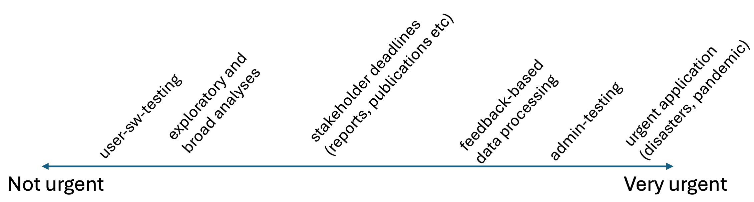
Context
DOE IRI vision to accommodate applications with diverse urgency requirements within a unified environment
An attempt to analyze scenarios where a fraction of jobs must be allocated urgently

Slide 4
Contributions
A comparative evaluation of four widely used job scheduling simulators
The design and implementation of an emulation-based methodology that operates on a real Slurm cluster
A suite of nine experimental scenarios that systematically explore combinations of QoS configurations, preemption strategies
Integration of visual analytics, including per-user timelines, scheduling and cluster utilization trends
A mapping between workload profiles and recommended scheduler configurations
Notes:
identifying their capabilities and critical limitations for modeling urgent and mixed-urgency HPC workloads.
enabling reproducible experiments with realistic user submission patterns, urgency levels, and QoS policies.
requeueing options, and workload characteristics, allowing detailed analysis of trade-offs between responsiveness, fairness, and efficiency.
and backfilling behavior, to provide actionable insights into how scheduler policies affect both urgent and normal workloads.
resulting in a practical hybrid scheduling strategy that HPC centers can adapt to balance urgent computing needs with sustained system utilization.

Slide 5
Survey / Evaluation of Job Scheduling Simulators
We begin with looking into the existing job scheduling simulators
Selected 4 representative simulators: Batsim, Accasim, Alea and The Slurm Scheduler

Slide 6
Job Scheduling Simulators: Batsim and Accasim
Batsim: modular and extensible, supports SWF and json formats, includes built-in tools to generate workloads and define simulated platforms; We were able to run Batsim with a custom workload that parameterizes number of jobs, submission intervals, walltime ranges and failure rates. However, we could not induce urgency QoS levels and preemption mechanisms.
Accasim: Python based; ingests SWF data, offers a limited built-in scheduling algorithms compared to Batsim, lacks dynamic job submissions, no native support for QoS levels or preemption mechanisms. We were able to run Accasim using Batsim generared loads. Difficulties in post-processing results due to limited labeling of outputs.
[Paper has comparison in more details]
P-F Dutot, M Mercier et al 2016. Batsim: a Realistic Language-Independent Resources and Jobs Management Systems Simulator. doi:10.1007/978-3-319-61756-5_10
C Galleguillos, Z Kiziltan et al 2020. AccaSim: A Customizable Workload Management Simulator for Job Dispatching Research in HPC Systems. doi:10.1007/s10586-019-02905-5
Notes:
Risk free analysis of systems, Repeatable and reproducible, Fast, Low overhead

Slide 7
Job Scheduling Simulators: Alea and the Slurm scheduler
Alea: Java-based, provides a few scheduling algorithms and user-defined scheduling policy; a form of QoS is supported via multiple queues however preemption is not supported. Alea turned out to be close to our requirements -- we engaged with its main developer and are in the process of adding features for ”AleaNG”
The Slurm scheduler: Aims to reproduce actual Slurm scheduling behavior in a controlled environment mimicking real environment as close as possible. Designed to run inside a Docker container. Posed challenges in deployment in lab managed environments. Current release runs an older Slurm (v20.11) compared to OLCF systems (v25.05)
D Klusacek, M Soysal, and F Suter. 2019. Alea - Complex Job Scheduling Simulator. doi:10.1007/978-3-030-432225_19
N A Simakov, R L DeLeon et al 2018. Slurm Simulator: Improving Slurm Scheduler Performance on Large HPC systems by Utilization of Multiple Controllers and Node Sharing. doi:10.1145/3219104.3219111

Slide 8
Feature gaps in simulators wrt our requirements
No native support for urgent QoS or urgency aware scheduling
Limited or no implementation of job preemption with realistic handling of cancellation or requeuing
Incomplete modeling of dynamic user behavior and event-driven job arrivals
Practical deployment barriers in our testbed environment
Nevertheless, job scheduling simulators are very valuable tools
Notes:
Even with extensive customization, these tools could not fully reproduce the operational conditions of a real HPC scheduler under urgent computing demands. This assessment led us to adopt an emulation-based methodology

Slide 9
A Rare Opportunity: “Emulating” Job Scheduling over a real Cluster
20 intel nodes with 64 CPUs (2 logical cores/CPU) and 2 Nvidia GPU nodes
Slurm version 25.05
Backfilling enabled for opportunistic job runs for all experiments
20 dummy user accounts were created: common group memberships and privileges

Slide 10
Instrumentation: Experimental Setup
run in sync
for 20 dummy users
invoke MPICatnap* with a
controlled runtime
Tmux session with 22 panes
genjobs script
slurm job
spec
MPIcatnap*
2 sessions
Generate job spec with randomized
and controlled parameters
submit at random intervals
control and monitor
* code courtesy: MJ Wilde, ANL/UChicago

Slide 11
Features / Benefits of the Experiment setup
Submit jobs for each user at randomized intervals
Randomized job parameters within defined limits: walltimes, node size, QoS
Customizable application runtimes
wrt to the job walltimes
The mock mpicatnap application:
cats an input file to an output file
runs sleep for defined time on all cpu cores
Monitoring enabled but may run unsupervised in tmux sessions
Notes:
So mpicatnap does not consume any resources
In summary: we were able to pack significant amount of features in a relatively tiny setup

Slide 12
Experiments Design: Nine experiments with varying conditions
User side: Variations in job sizes, wallclock times, application runtimes, requested QoS
Slurm side: Variations in QoS definitions -- preemption vs prio boost, preempted jobs requeue vs cancel
E1, E2 and E4: Calibrations on short and long, fixed and varying number of jobs, timeouts, backfill verifications
E3: 20 jobs/user, 5-10% urgent jobs, preempt and cancel
E5: Same as above, except no preemption + priority boost for urgent jobs
E6: Same as E3 except preempt normal jobs to requeue
E7: Short 10-min app runtime that is 10-20% of job walltimes, preempt and requeue
E8: Same as E7 except preempt and cancel
E9: Same as E7 except app runtime is 80-90% of walltimes, preempt and cancel

Slide 13
Visual overview of all experiment runs
Plots show jobs’ end state vs wait time in queue for each job across all experiments
Note the differences in the Y-axes values to indicate the disparities in the wait times resulting from each experiment setup

Slide 14
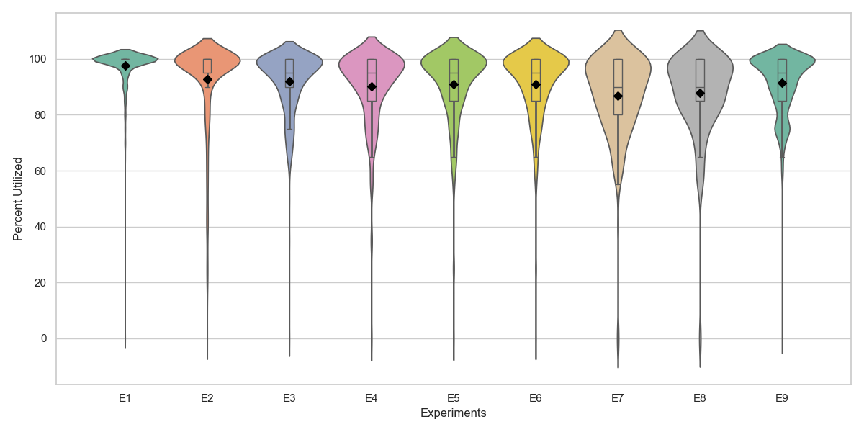
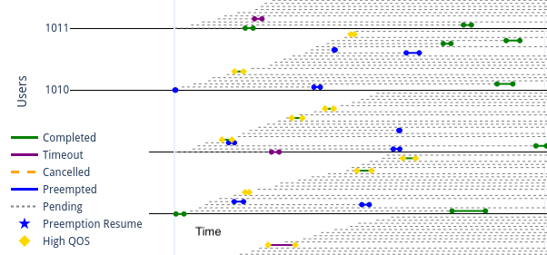
Results Visualization: User view of jobs and cluster utilization
. . .
“Swimlanes” for user job states and events
Gives a vizualization of simultaneous events for users
Cluster utilization via sinfo (probed once per min)
violin width = distribution at that percent utilization Diamond = mean, box = median and quartile

Slide 15
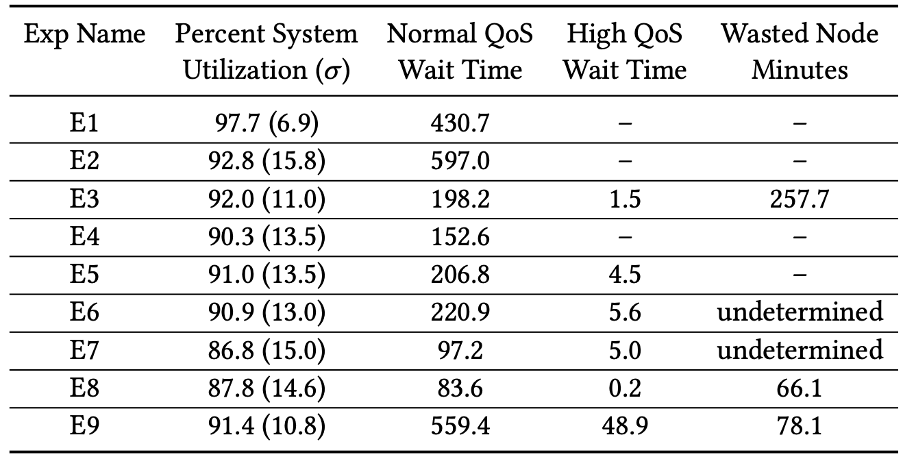
Statistical Analysis for various outcomes on each of the experiments
Tradeoffs between system utilization and user outcomes (both normal and urgent) under various Experimental conditions!
No single ”ideal” setup

Slide 17
Results Interpretation

Slide 18
Conclusion and Future Work
An emulator for job scheduling emulating tunable, real-world job scenarios
Alea -> AleaNG addressing the limitations of simulators and enabling many more experimental scenarios

Slide 19
Acknowledgements
This research used resources of the OLCF at ORNL, which is supported by DOE’s Office of Science under Contract No. DE-AC05-00OR22725.

Slide 20
Thank You for your time! Questions?
km0@ornl.gov | https://github.com/ketancmaheshwari/wiuhpc25

Slide 21
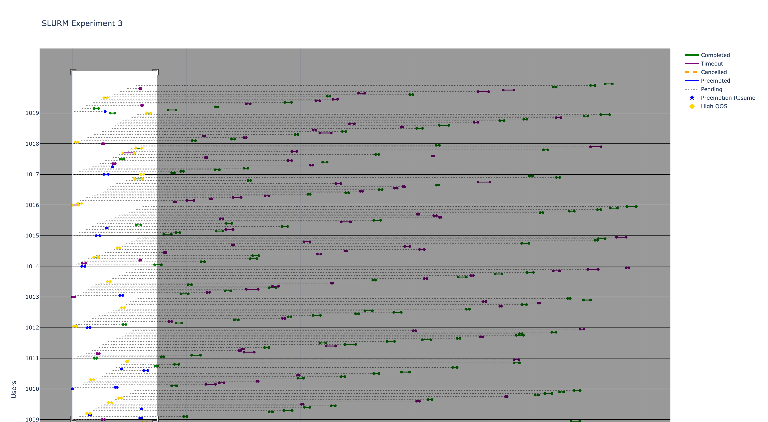
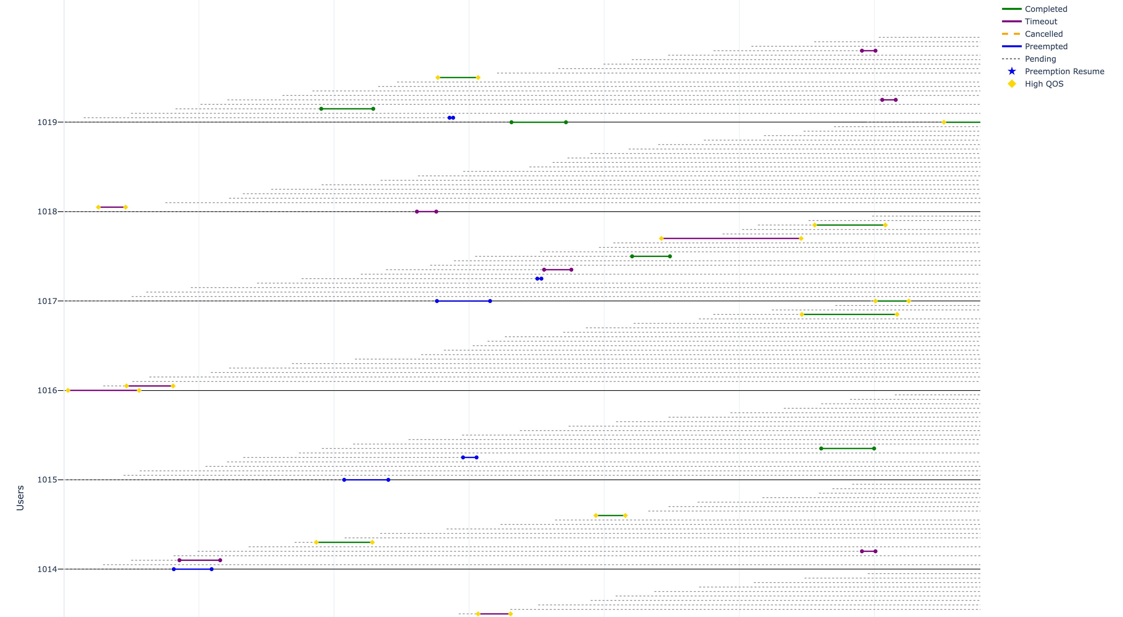
Dynamic and interactive plots that may be selectively visualized by timeslice or by user(s)
Overall View, regions may be selected
for enlargement
Enlarged view

Slide 22
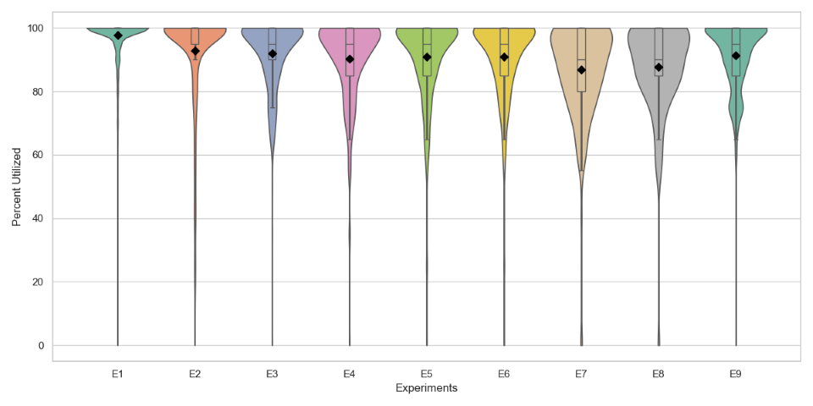
Extra Slide: Violin plot for system utilization without the extrapolation

